Slide 1


Importance-Performance Analysis
Mercer University Data Analysis using Parent Samples
By: Yasika Mahesh Sawant

Slide 2







Overview of Presentation
INTRODUCTION
SURVEY RESULT
ANALYSIS
NEEDS IMPROVEMENT/RECOMMENDATIONS
CONCLUSION

Slide 3

Introduction
The survey report presents the findings of an Importance-Performance Analysis (IPA) conducted using IBM SPSS software
The data focuses on Importance and Performance of various dimensions of Mercer University.
Objective is to find the key dimensions which needs more attention.
The IPA framework will guide us in pinpointing which aspects of the university’s operations are most crucial to students and need improvement.
Providing recommendation based on the insights.

Slide 4
Survey:
Mercer University | Mercer University | Mercer University | Mercer University | Mercer University | Normalized Scores | Normalized Scores
Survey Questions | Importance Mean | Normalized Score | Performance Mean | Normalized Score | Importance | Performance
The college has a very good academic reputation | 5.19 | 0.70 | 5.14 | 0.28 | 0.70 | 0.28
The college's graduates get good jobs | 5.15 | 0.62 | 5.17 | 0.39 | 0.62 | 0.39
The college graduates a high percentage of students | 5.19 | 0.70 | 5.31 | 0.84 | 0.70 | 0.84
Importance - The cost of attending the college is a good value | 5.17 | 0.66 | 4.80 | -0.83 | 0.66 | -0.83
The college has a good reputation for its social activities | 4.42 | -0.77 | 4.95 | -0.34 | -0.77 | -0.34
The college is the right size for my child | 4.95 | 0.24 | 5.05 | 0.01 | 0.24 | 0.01
The college is in a good location for my child | 5.00 | 0.34 | 5.28 | 0.73 | 0.34 | 0.73
I am okay with my child attending the college | 5.21 | 0.74 | 5.42 | 1.19 | 0.74 | 1.19
The college is highly regarded by my child's teachers/guidance counselor | 4.18 | -1.22 | 5.16 | 0.35 | -1.22 | 0.35
The college has the type of major my child wants | 5.44 | 1.17 | 5.32 | 0.87 | 1.17 | 0.87
My child has friends attending the college | 3.92 | -1.71 | 4.39 | -2.15 | -1.71 | -2.15
The best academic students in my child's high school attend the college | 4.05 | -1.46 | 4.63 | -1.35 | -1.46 | -1.35
Mean | 4.82 | 0.00 | 5.05 | 0.00 | 0.00 | 0.00
Standard Deviation | 0.527347988 | 1.00 | 0.309674 | 1.00 | 1 | 1
Abbreviations
Academic reputation
Good Jobs
High graduation Rates
Cost of Attendance
Good social activities
Right Size
Good Location
Parents Agreeing
Highly regarded
Offers desired major
Friends attending College
Best Students attend this College

Slide 5
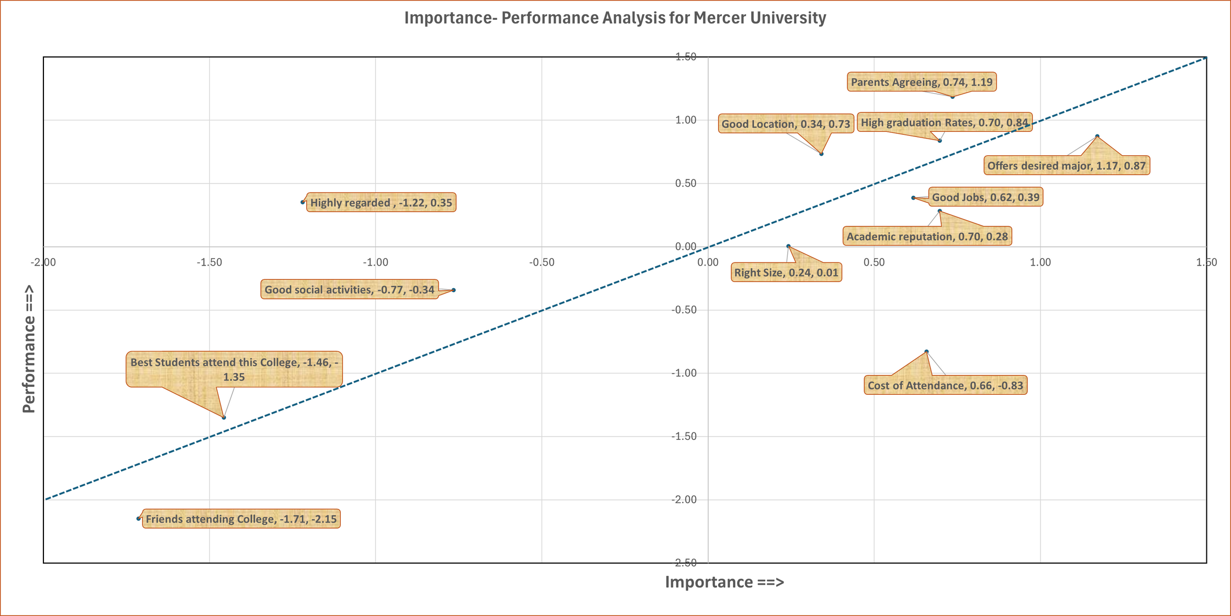


Analysis : 4 Quadrants
Importance - Performance Analysis for Mercer University
Low Importance, High Performance (Possibly Overkill)
High Importance, High Performance
Low Importance,
Low Performance
(Room for Improvement; Not too concerned)
High Importance, Low Performance

Slide 6
Analysis : 45-Degree Line
Importance - Performance Analysis for Mercer University
Above 45-Degree Line “Don’t need fixing”
Below 45-Degree Line “Need to be fixed”

Slide 7
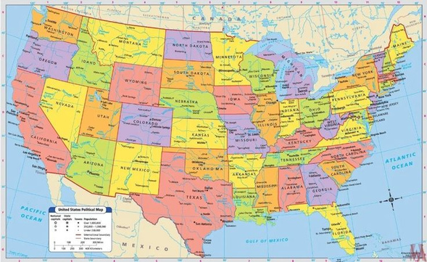


Resources doing Great!
LOCATION
HIGH GRADUATION RATE
PARENTS AGREEING
Atlanta, Macon, Suwanee, Columbus
Positive attitude towards child studying in Mercer University
64 % leading amongst top 10 universities

Slide 8

Need Improvement/ Recommendation
1
COST OF ATTENDANCE
Increase the number of merit-based scholarships
Review and potentially expand need-based financial aid program
Corporate Partnerships
Cost-Effective Education
Promote cost reduction strategies
Survey from existing students/Alumni
2
RIGHT SIZE
Upgrading existing infrastructure
Thorough Analysis on Student Enrollment and capacity
Advancement in technology and room for hand on experience with equal opportunities for students.

Slide 9

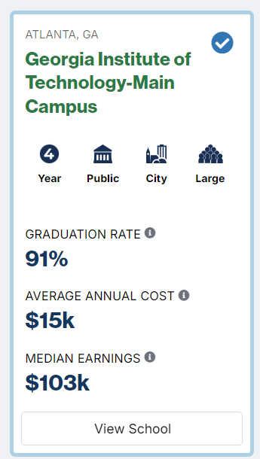
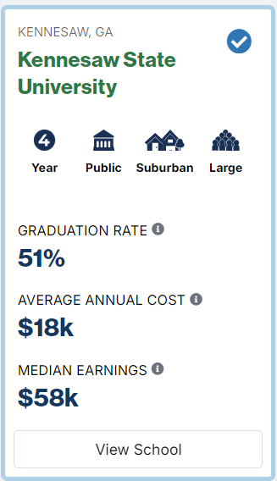
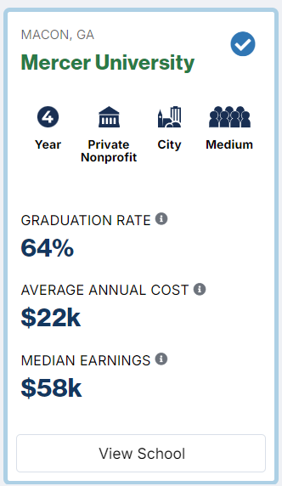
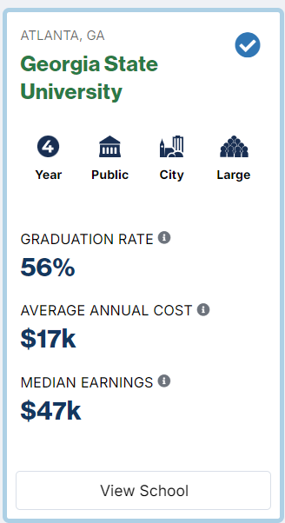
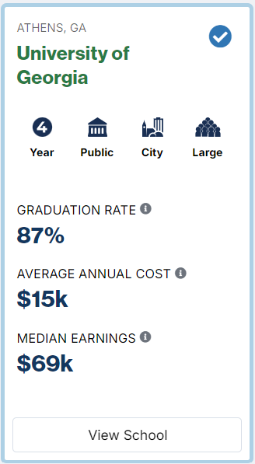

Slide 10

After Analyzing data based on Importance- Performance it concludes that amongst all the 4 quadrants the High Importance & Low Performance resources are crucial for students but falls short in performance.
Good Location, High Graduation Rate and Parents agreeing are highly valued by students and performing great which lies in a High Importance - High Performance quadrant.
Whereas, Cost of Attendance and Right size which lies in a High Importance - low Performance quadrant not meeting as per students satisfaction.
And other quadrants with LI-LP and LI-HP are not too concerned or not too important for students while taking admissions.
The scatter chart, with its four quadrants and 45-degree line, helps to visualize and interpret the Importance-Performance Analysis by illustrating how different factors align with their importance and performance levels.
Conclusion

Slide 11

Thank you!

